Slide 1
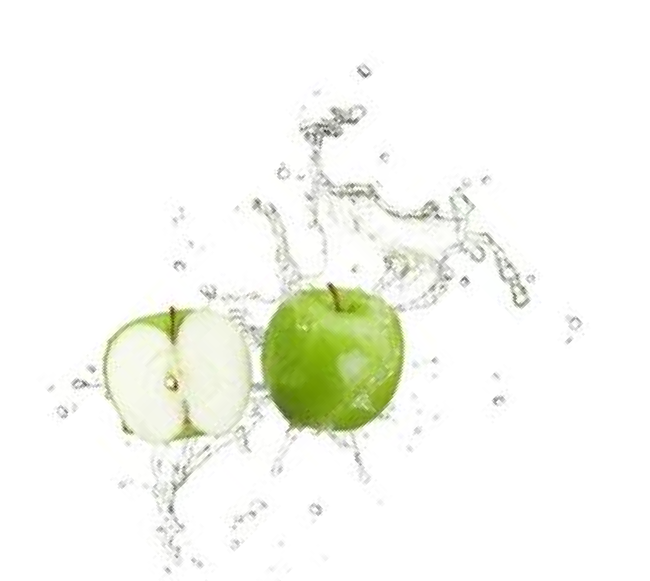
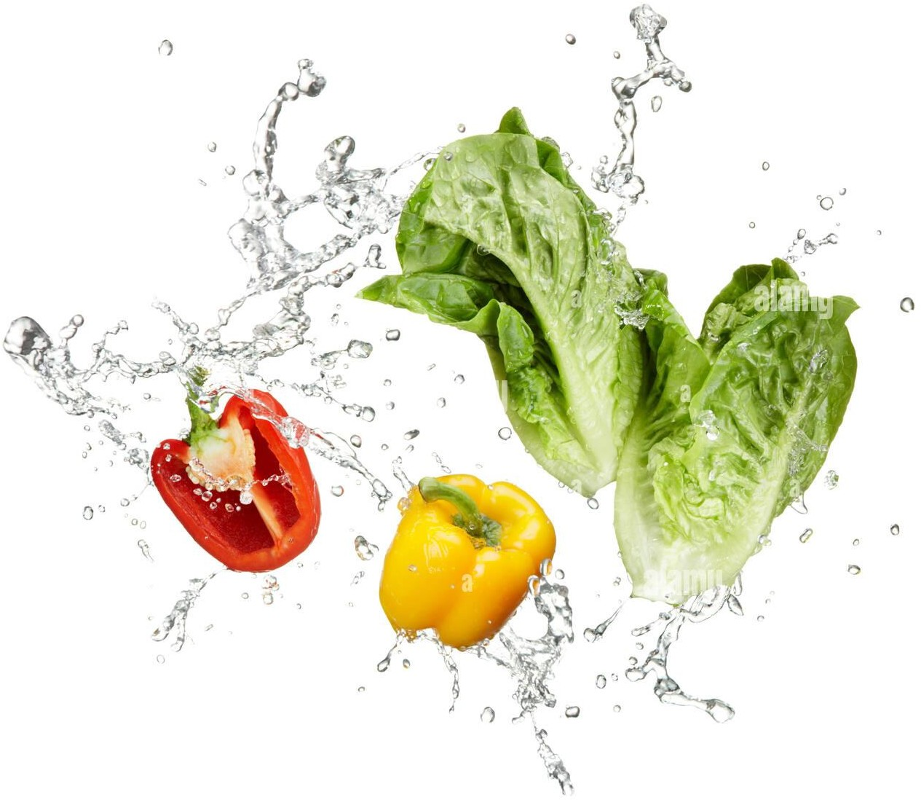
Flexible preservation in​ natural controlled atmosphere

Slide 3
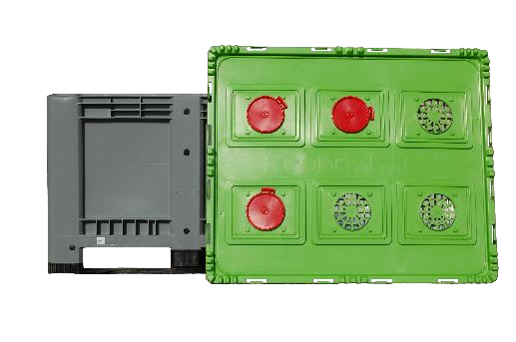
Value proposition
Design and commercialize of the solutions allowing storage in​ modules under atmosphere controlled.
Adaptation has 53 fruits and
vegetables. Increase in their durations of conservation
Increase THE income
Conservation Flexible
valuation of the production agricultural
Decreases THE waste
Improved there quality
Maintenance of the product quality over long periods
Ecologically
sustainable
Modular
Innovation :
Patent deposit on 90 countries
3

Slide 4
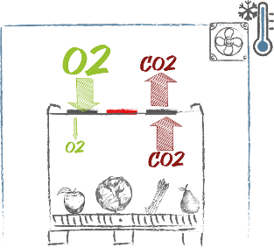
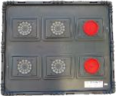
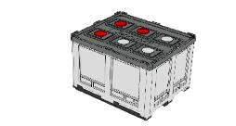
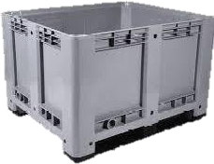
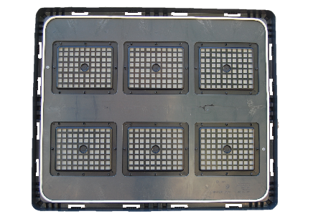
Our modules
The stored product create your own atmosphere controlled by has his breathing and the technology JANNY MT
+
=
there membrane Janny MT optimizes the O2 – CO2 balance and waterproofing of the module allows freshness and weight to be maintained ( weight loss < 1%) by a Hygrometry optimal .
Best quality of storage grace has the adjustment
simultaneous of the 3 pillars of there conservation :
Temperature
Relative humidity​​​​​​​​​​​​
Balance O2​ / CO2​
The modules are washable
waterproof and reusable .​ Their duration of life is more of 15 years .
4

Slide 5
Concept : Controlled atmosphere
MAINTAIN THERE FRESHNESS OF THE FRUITS
AND VEGETABLES VIA OPTIMIZATION
OF TWO PROCESSES :
Slow-down of their breathing Limitation of the loss in weight
APPLICATION :
Conservation of the fruits and vegetables
Storage
Transportation
5

Slide 6
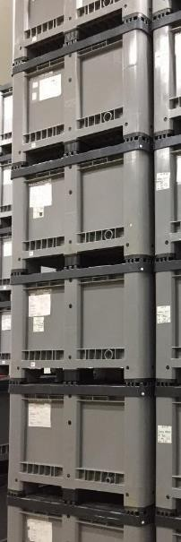
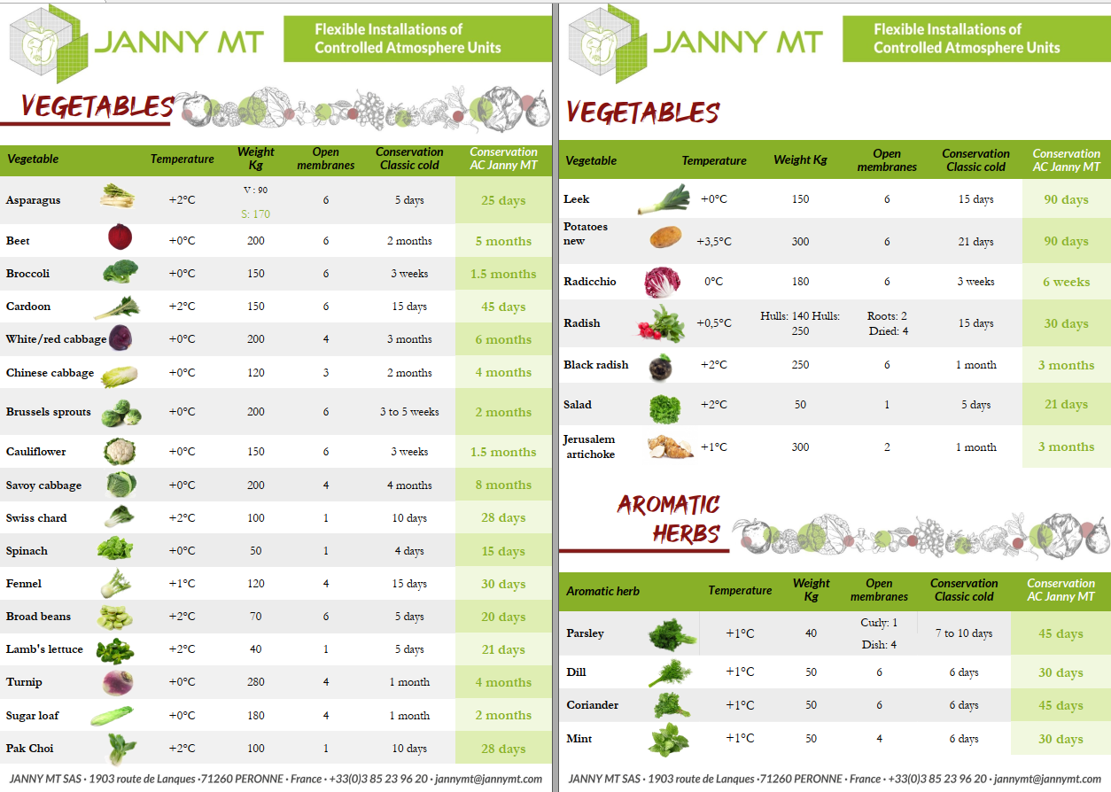
Preservation opportunity​
+ 10 years of R&D keep on going For operational results​ on + 45 fruits And vegetables
Extension of there season of sale For THE producers
7

Slide 7
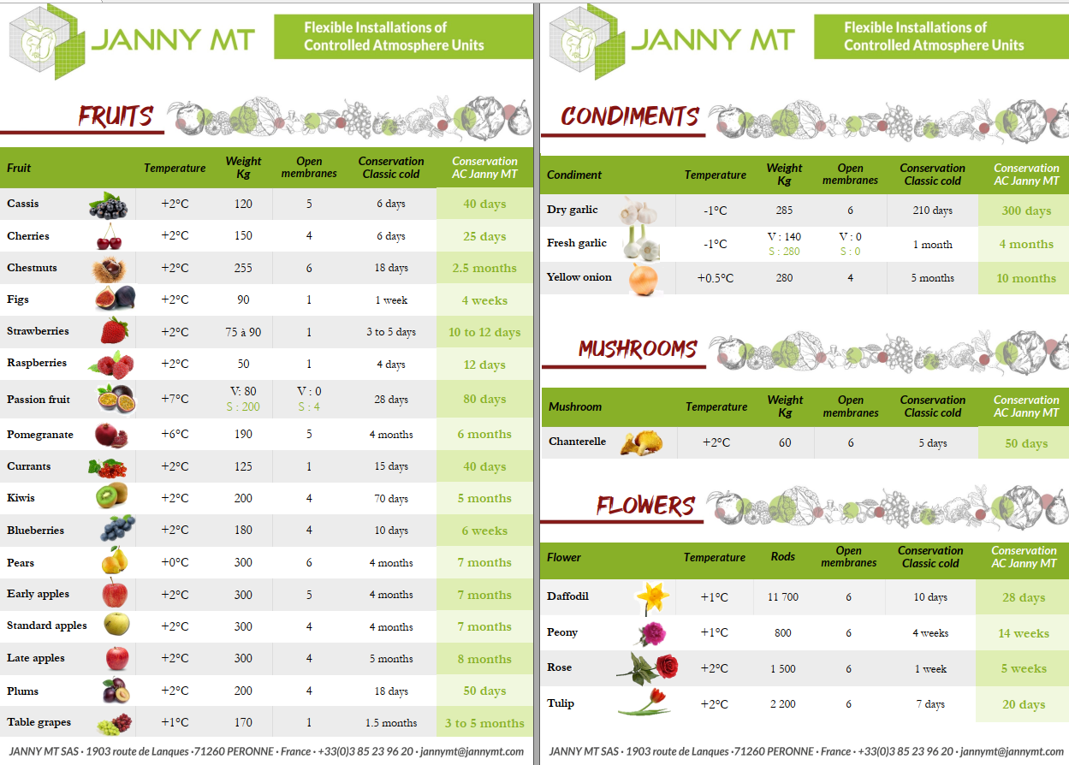
Preservation opportunity​
+ 10 years of R&D keep on going For operational results​ on + 45 fruits And vegetables
Extension of there season of sale For THE producers
7

Slide 8
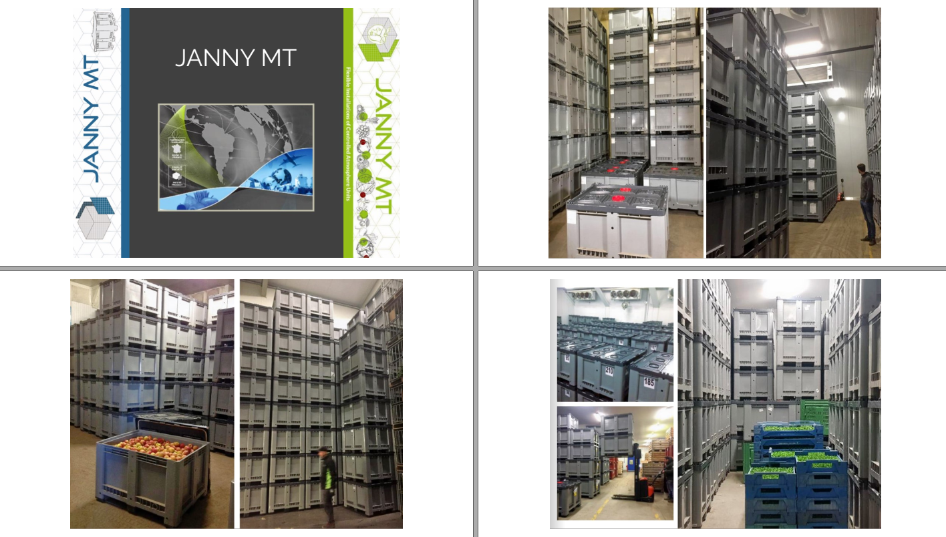

Slide 9
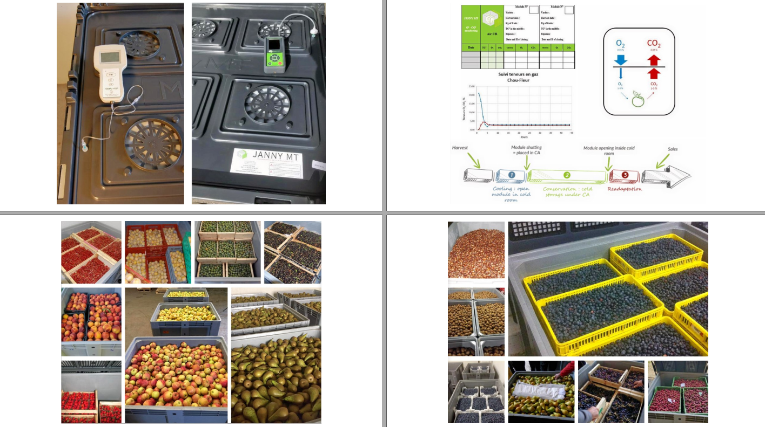

Slide 10
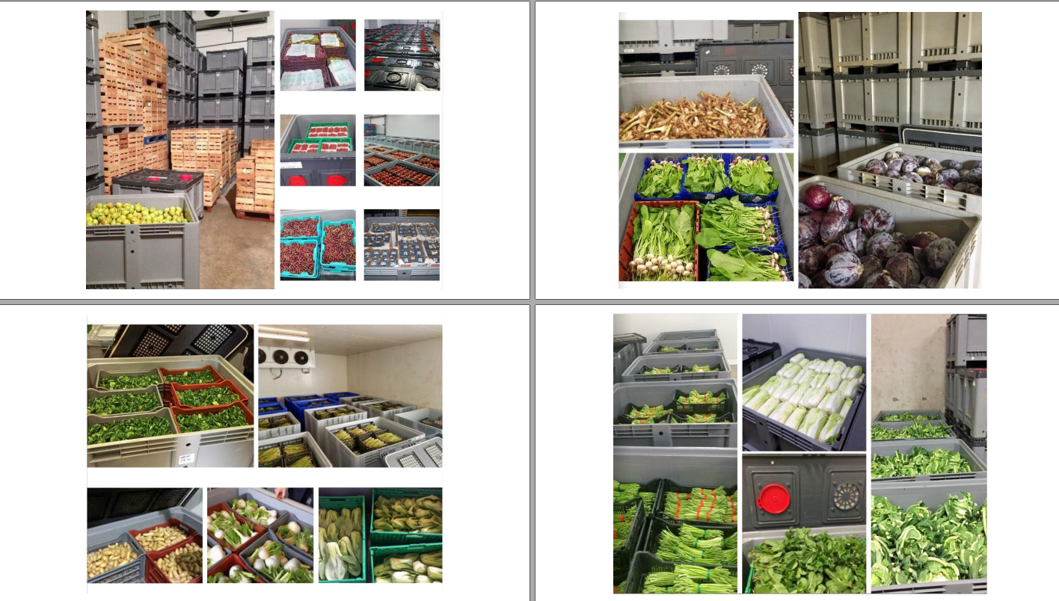

Slide 11
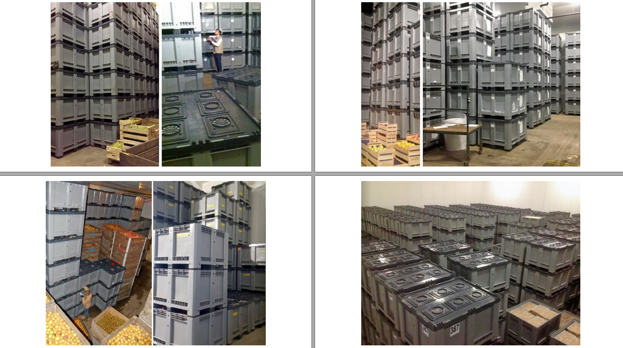

Slide 12
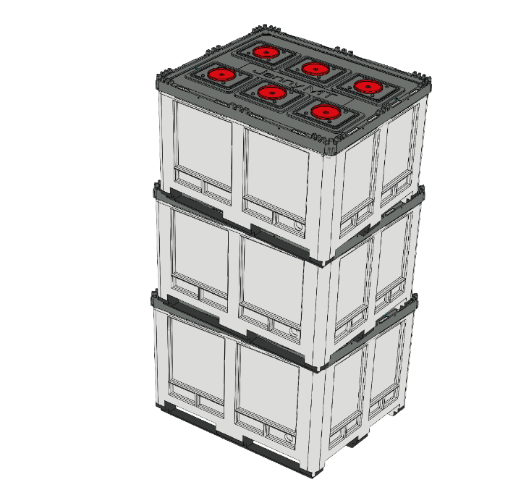
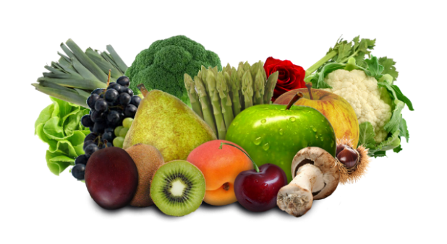
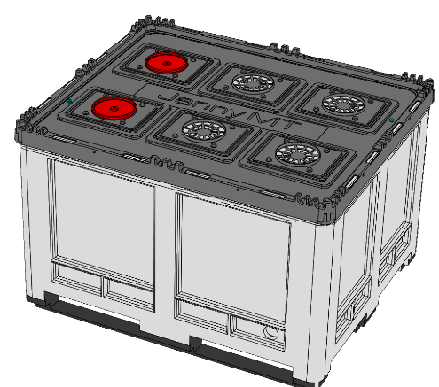
Reduce waste and add value to local products with JANNY MT
Fighting waste and losses
Issues
Field losses: bad weather, production peaks, overproduction, unharvested production (market price too low).
Post-harvest and storage losses: Sorting, weight loss (dehydration).
Mismatch of supply and demand: periods of poor sales (holidays), regularity of supplies
With Janny MT
Valorization of 10 to 30% of overproduction < 1% weight loss
Trimming and peeling reduced by 80%
Avoid 10 to 30% losses between fields and distribution.
Strong, innovative and sustainable
An investment for the environment and the local

Slide 13
Reduce waste and add value to local products with JANNY MT
Valuing the regional products of producers and cooperatives
Issues
Expand the offer and maintain the quality of local products longer.
Ensuring local sales as a priority.
Reduce import requirements
Provide local markets more regularly: restaurants, schools, canteens…
With Janny MT :
Improve the quality of fresh and local products after harvest for consumer satisfaction Creation of new local markets: cabbage and leeks 12 months out of 12
Opportunity to produce more locally to supply the local market Reduce transport needs thanks to volumes stored and sold locally
Safeguarding local producers, helping them to stay, by improving the farms profitability
An investment for the optimization of local farms

Slide 14
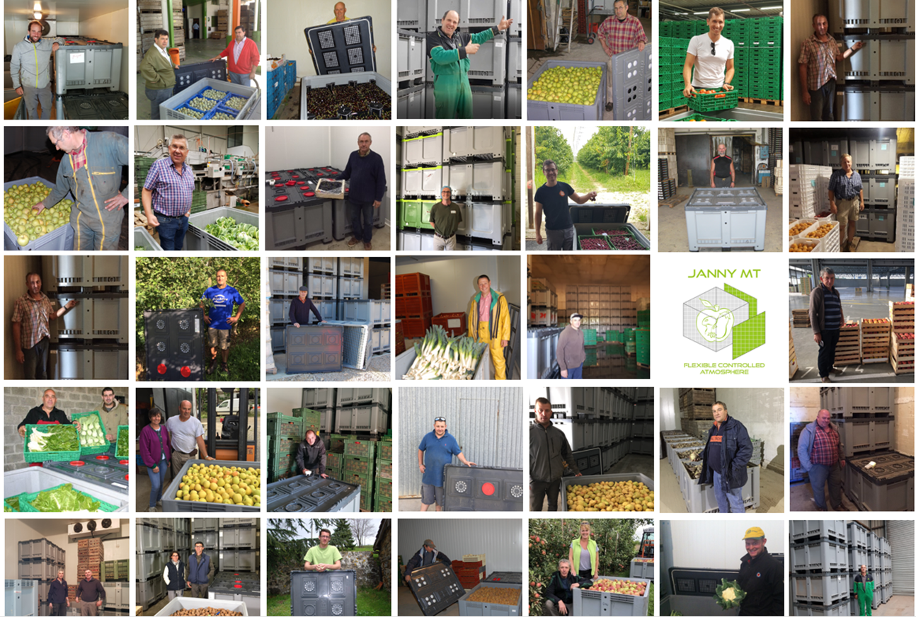
THANKS​​
JANNY TM – There Condemin – 71260 PERONNE
jannymt@jannymt.com – +33.3.85.23.96.20
Find us on the Internet
www.jannymt.com
BFGS SIA
Dzelzavas 79-60, Riga, LV-1084
info@logeq.eu –
+371 29556922
www.logeq.eu

